Slide 1
Group 7
Kunj Desai
Saumitra Natu
Farin Habib
Neel Rana
Prathiksha Balakrishna
James Ortiz

Slide 2
Outline
Introduction
Security
Project Structure
Micro services
Services: Authorization, Product, Price, Stock, Review
Roles
Snap shots of the website

Slide 3
Introduction
Technologies we used -
Front-end: React, Redux, CSS, Bootstrap
Back-end: Java Spring-boot
Database: MySQL
Deployment: Docker
For our case study, we have created an online application in which users can access services like products, prices, reviews, and stock. Each of these services have their own features, such as create, update, search, and delete. Also, users can register accounts and login to have access to these services.

Slide 4
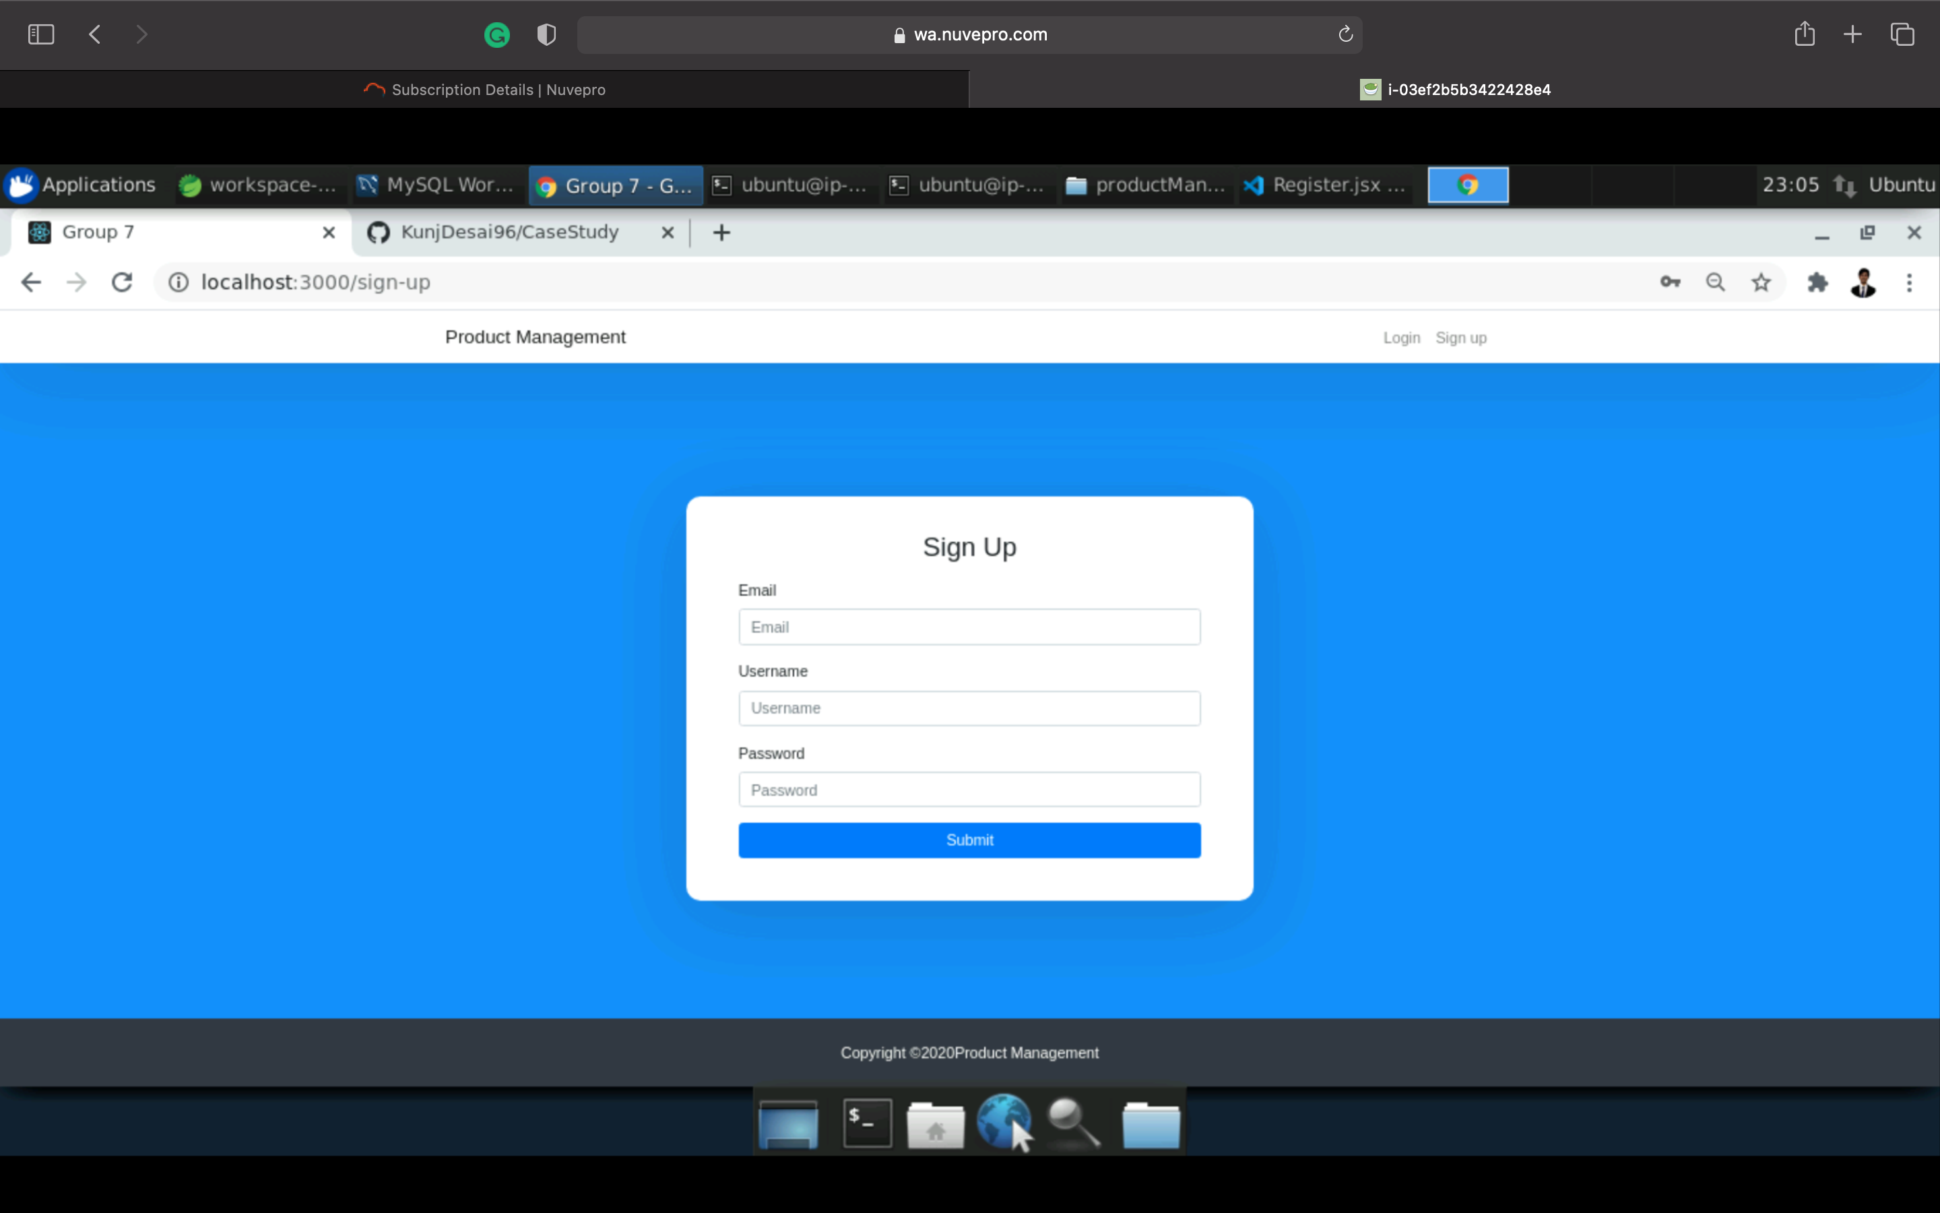
Security
Provision for a user to securely register.

Slide 5
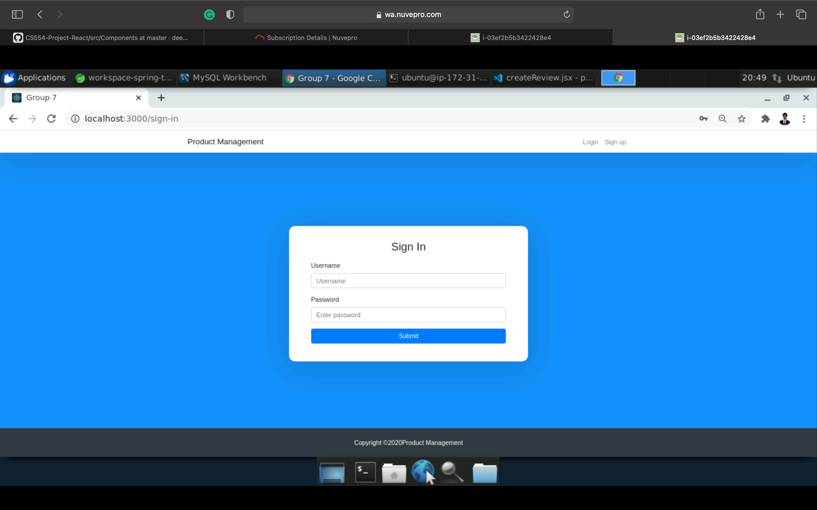
Security
Provision for a user to securely login.

Slide 6
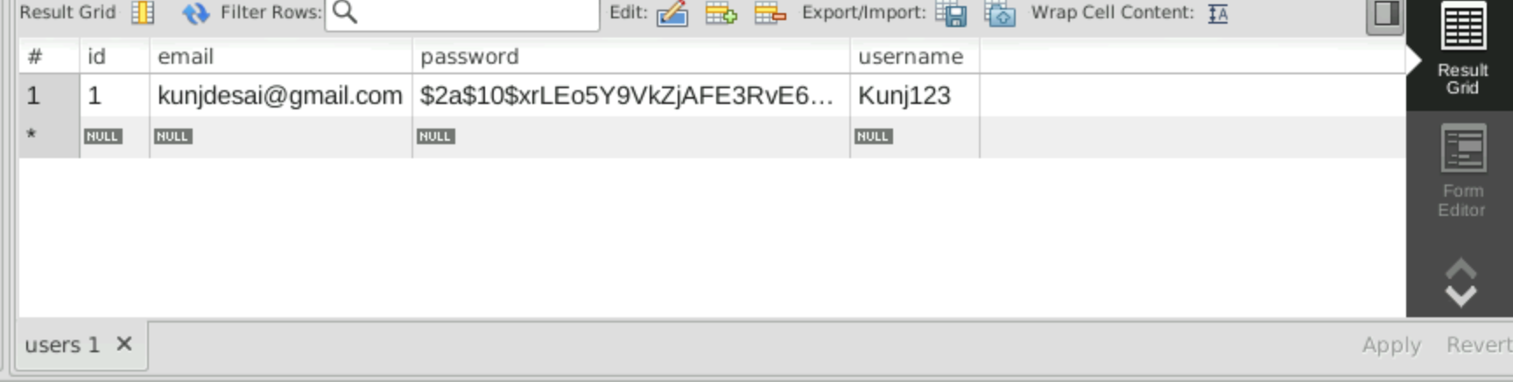
Security
The user-details are stored in the backend with MYSQL database in a secured way using encryption .

Slide 7
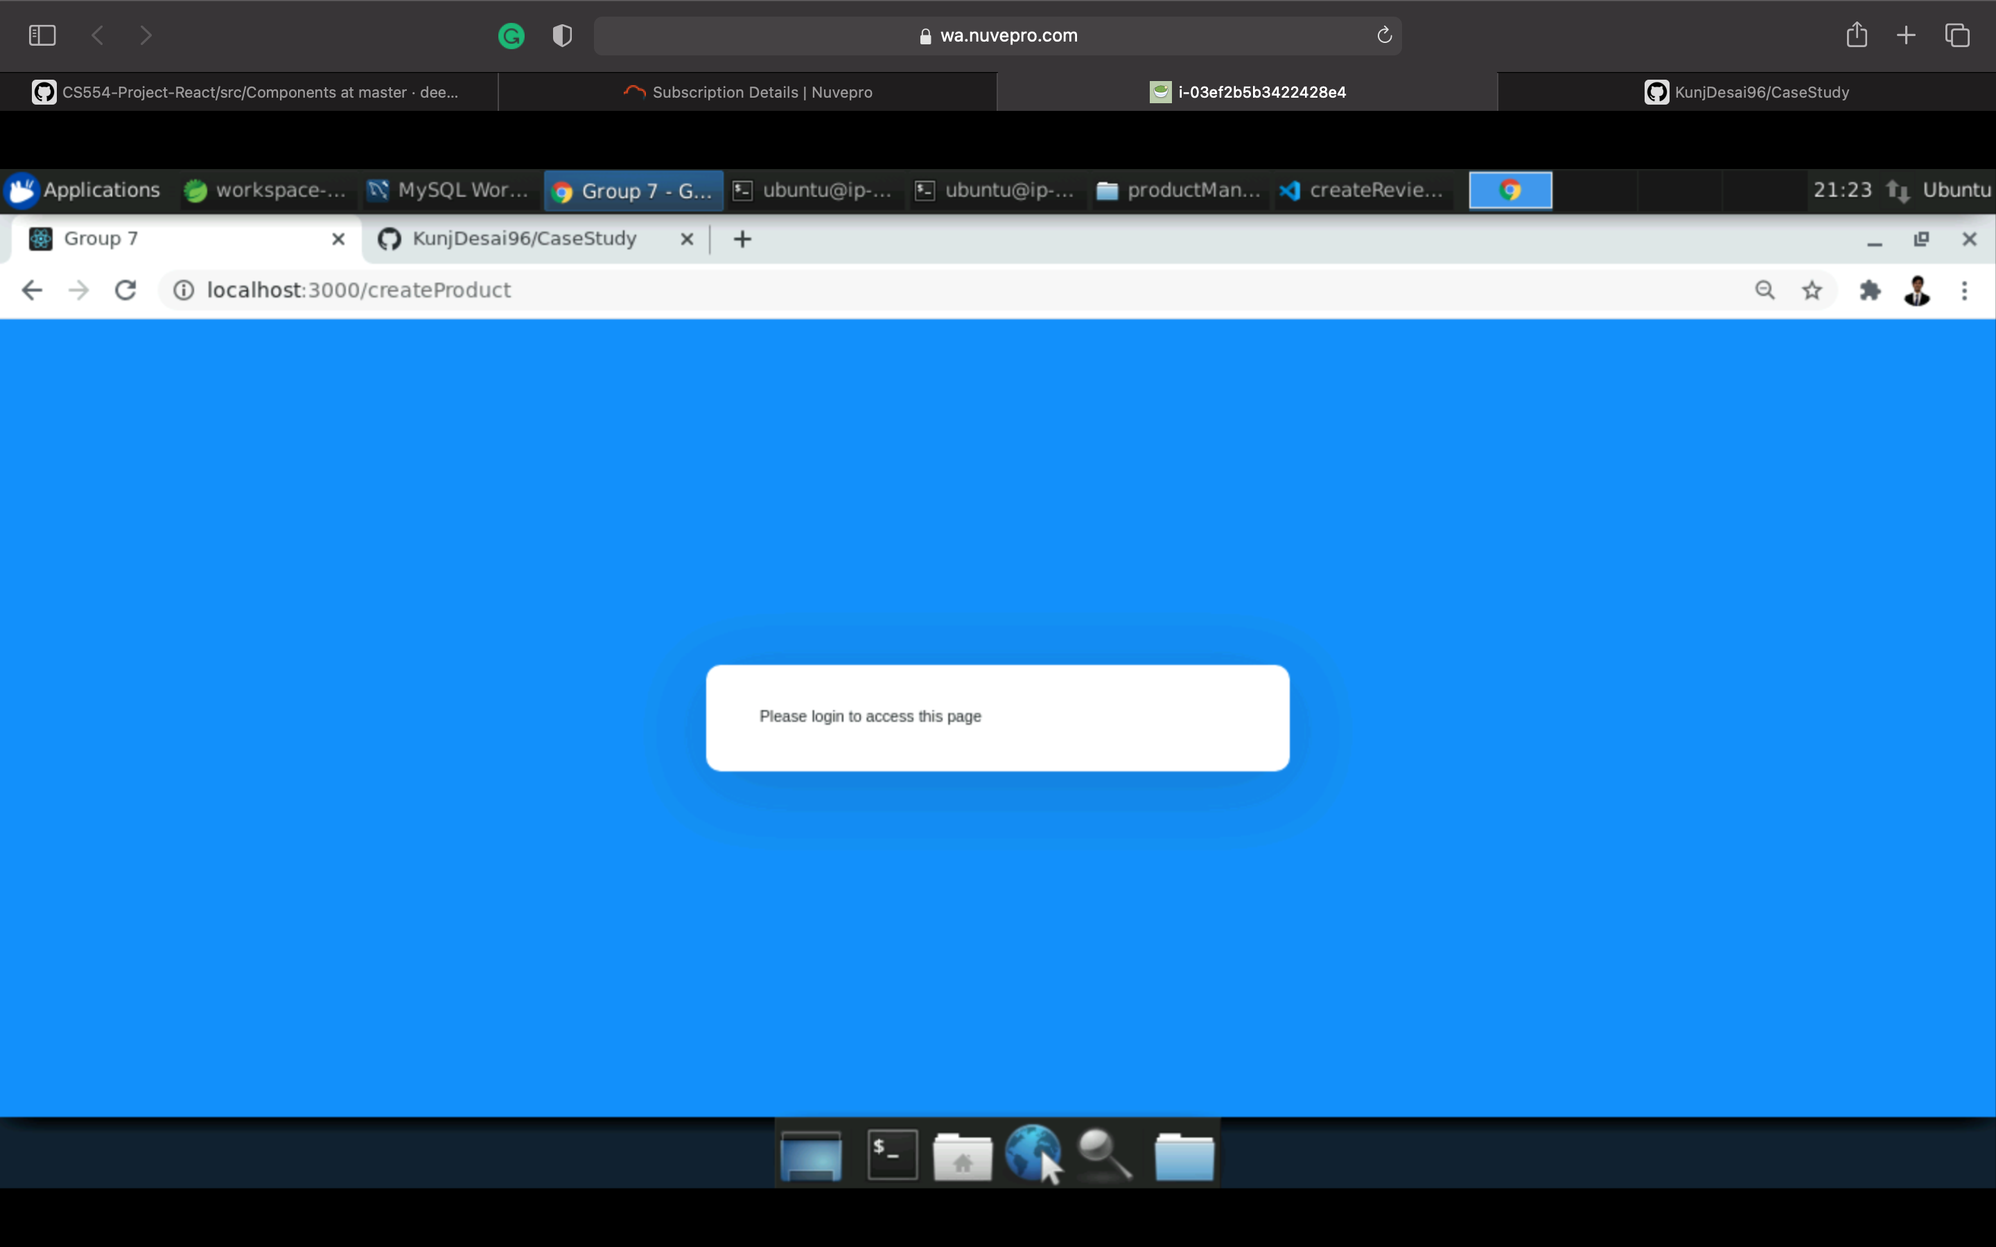
Security
Implementation of website authentication that ensures that a user is unable to access the services without logging in to the application.

Slide 8
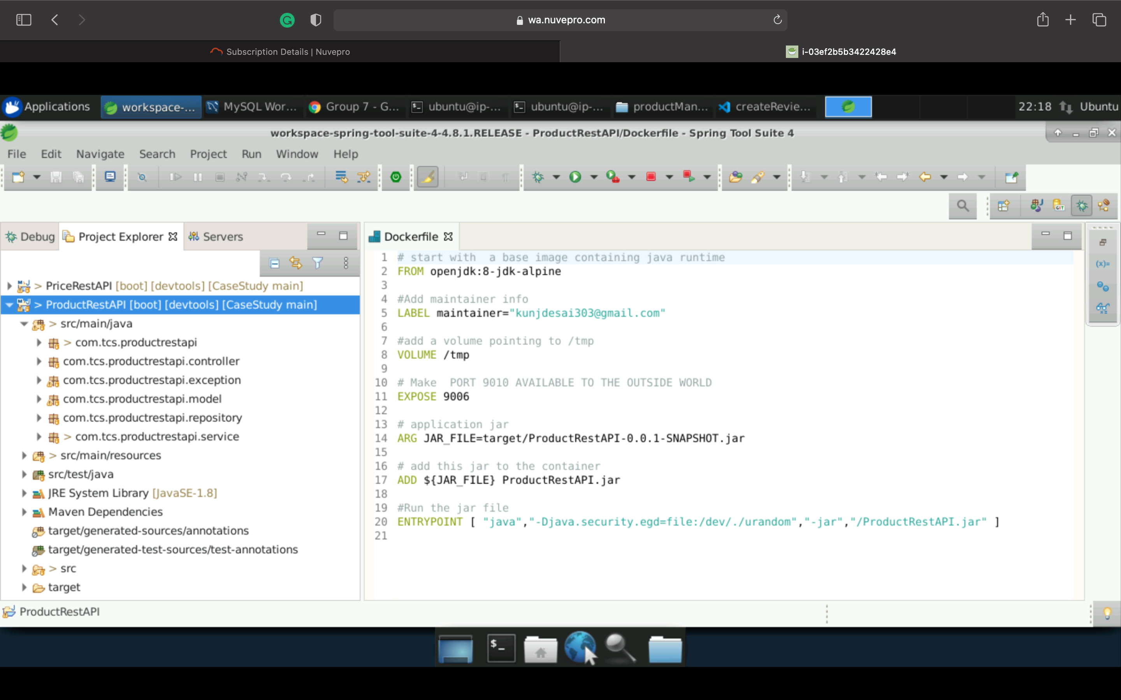
Project Structure
Backend:
Controllers, Models, Services, Exceptions, and Repositories.

Slide 9
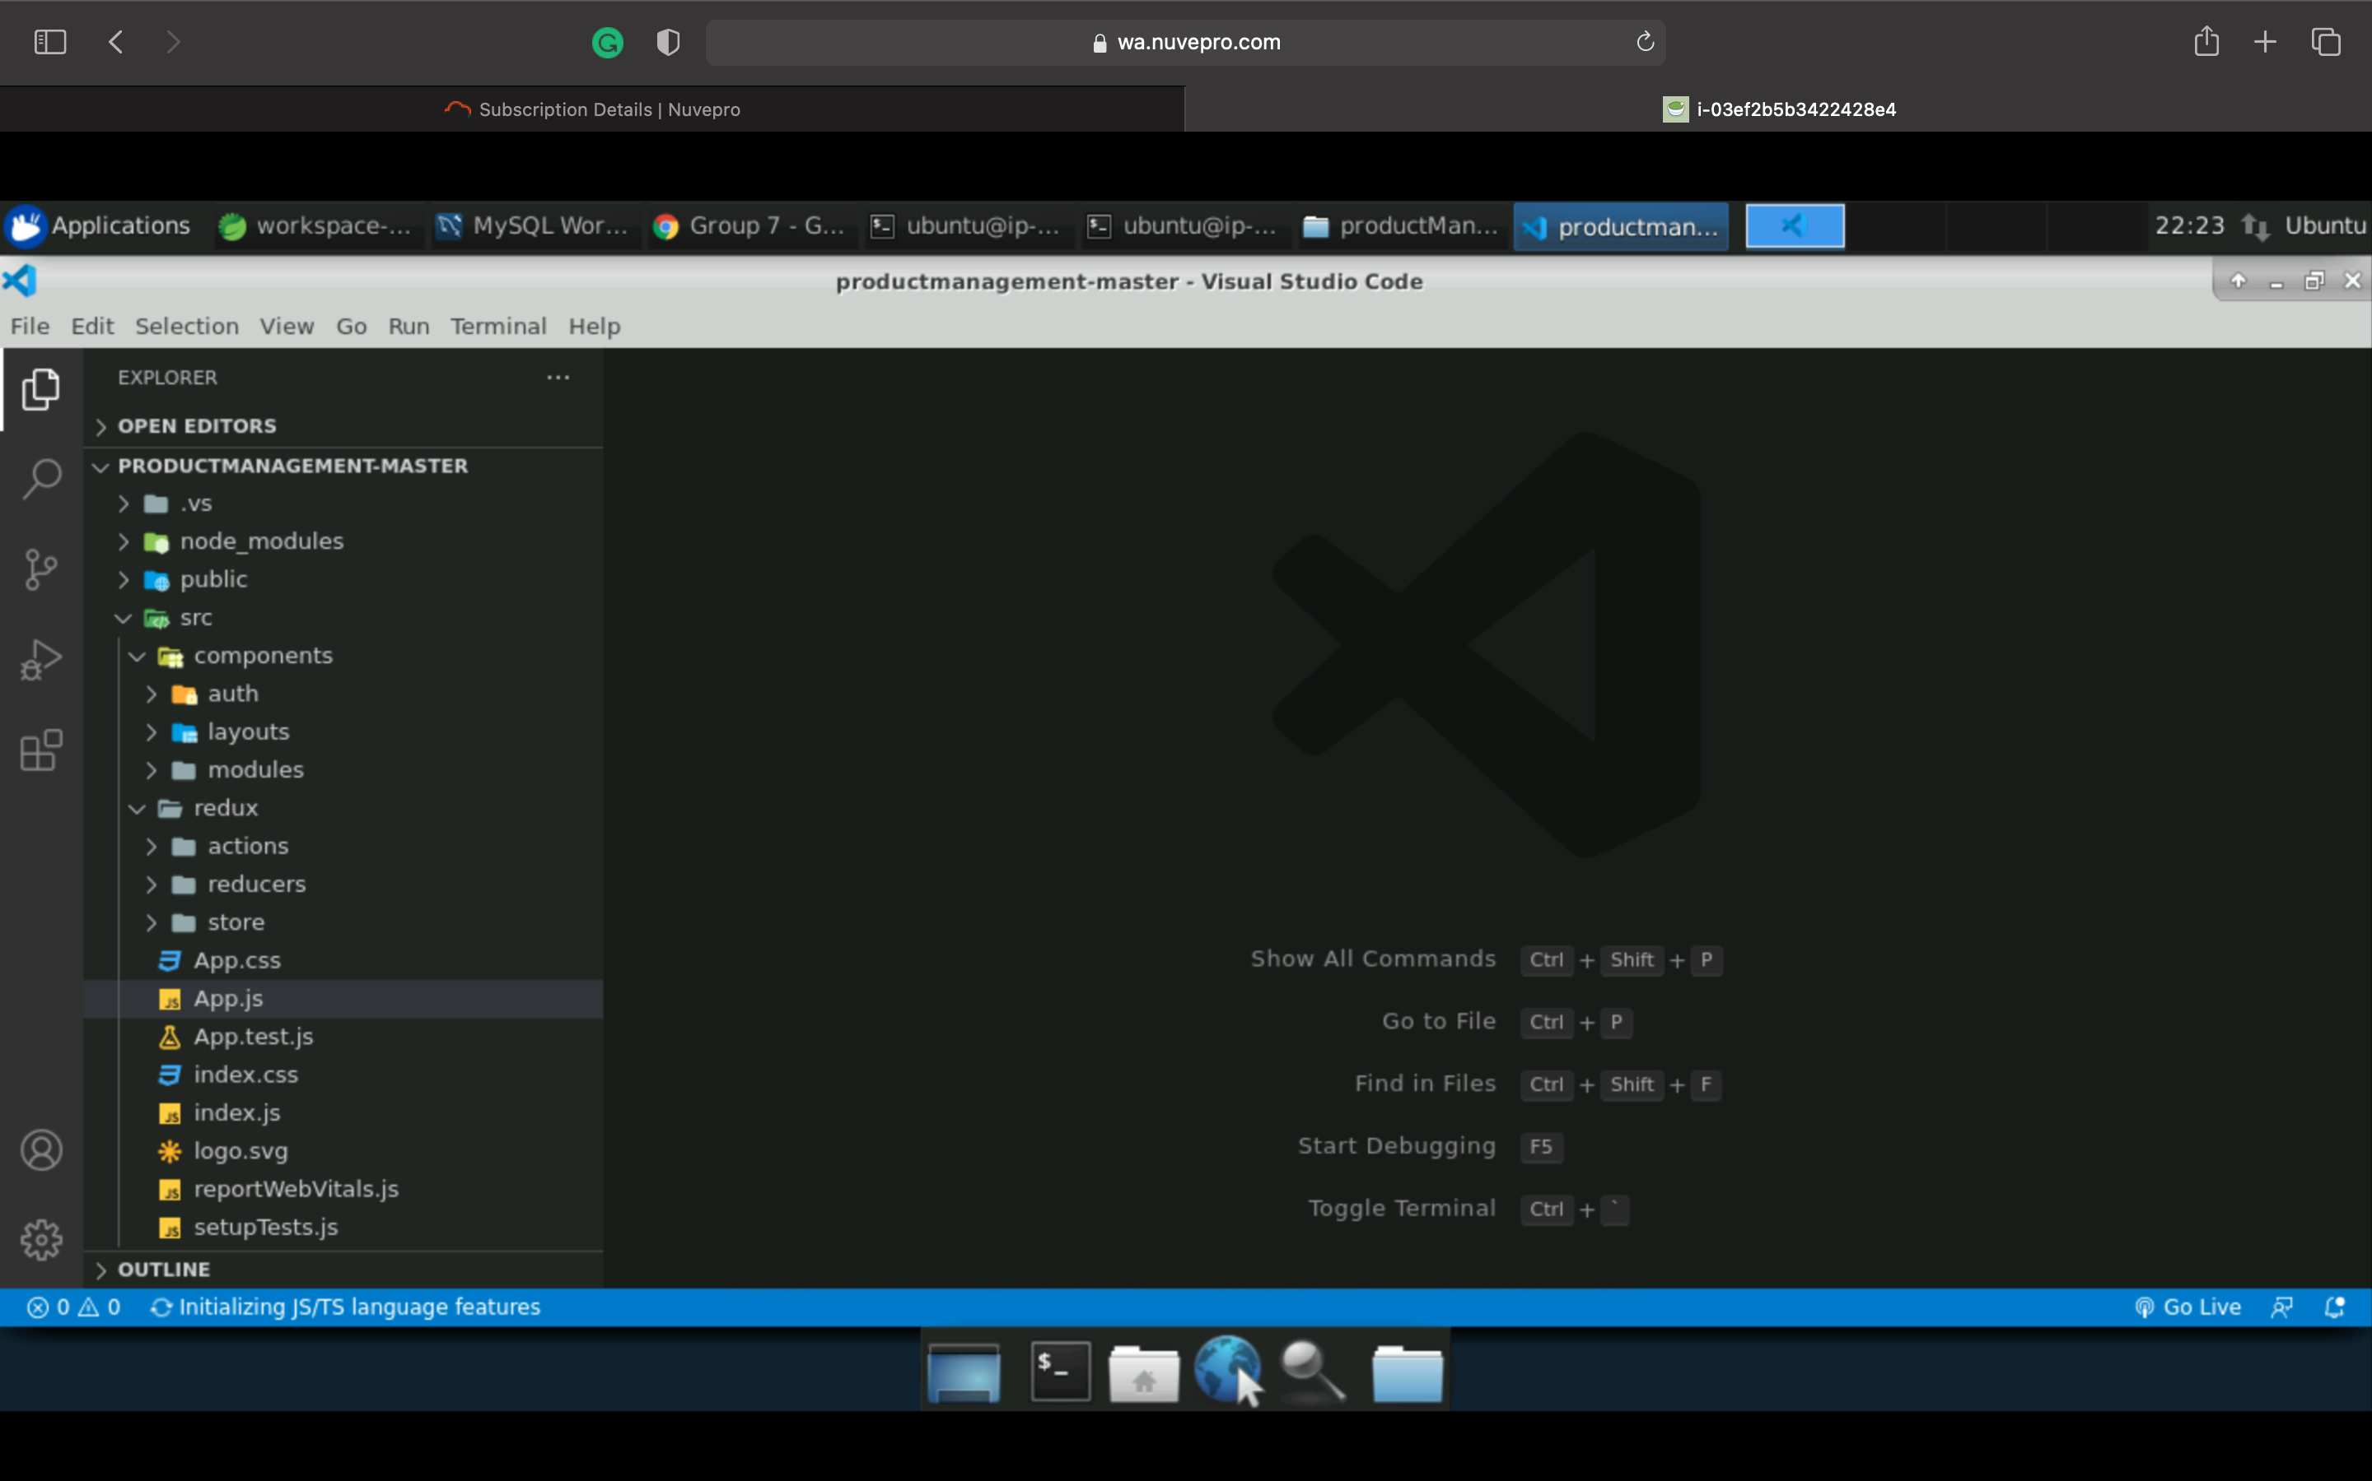
Project Structure
Frontend:
In components we have auth, layouts, modules
In redux we have actions, reducers, store

Slide 10
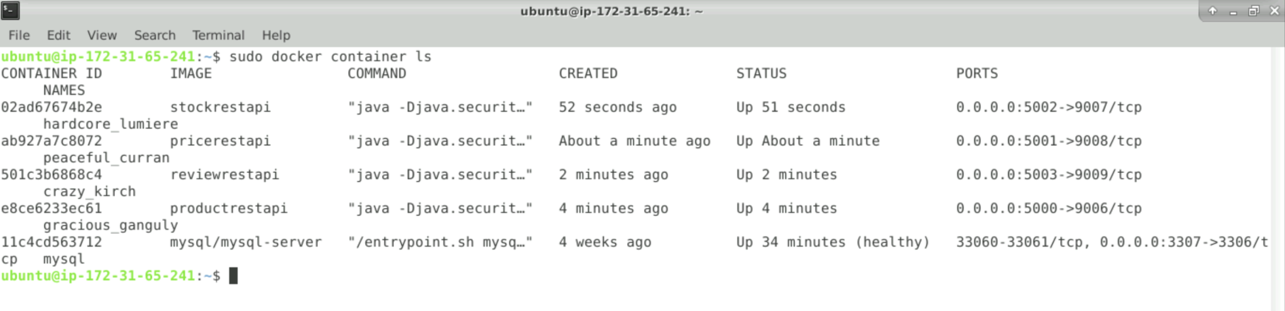
Microservices
Deployment of all the services in respective containers creating own images for each service.

Slide 11
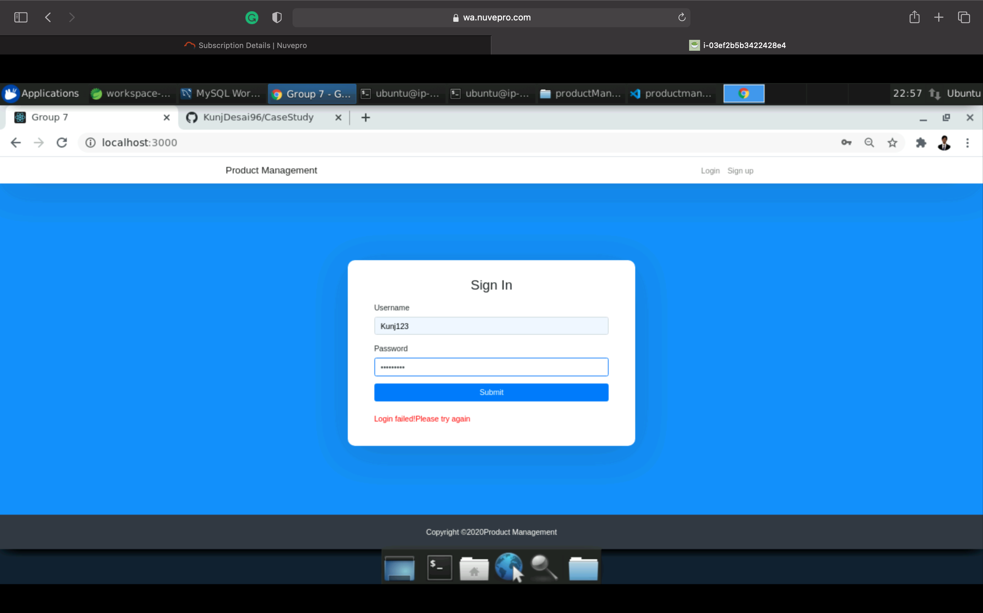
Services
AUTHORIZATION : This service helps user to sign in if the user doesn’t have the account and to log in if the user already has an account to access rest of the services.

Slide 12
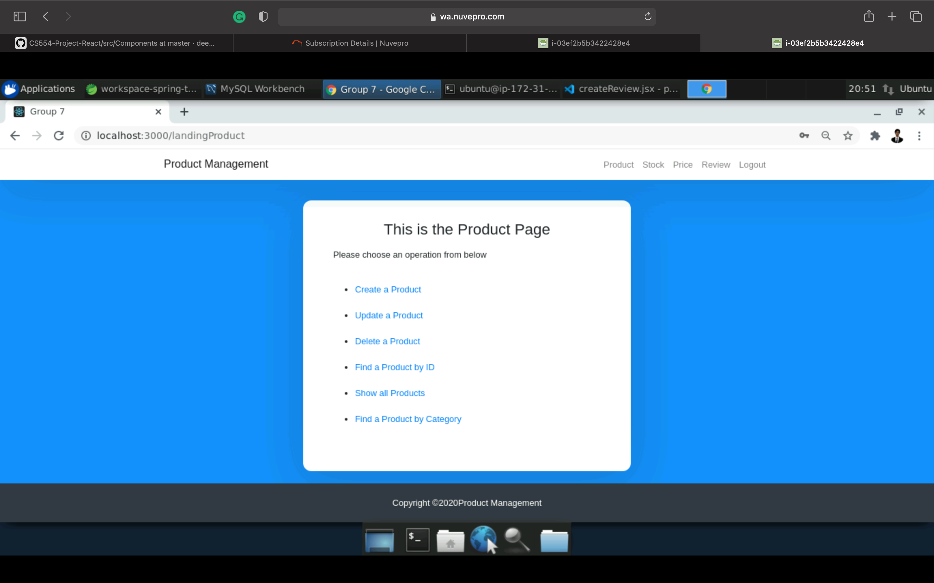
Services
PRODUCT: This service helps the users to create the product, update the product, fetch the product by its ID, delete product by its ID, fetch all the existing products and based on the category .

Slide 13
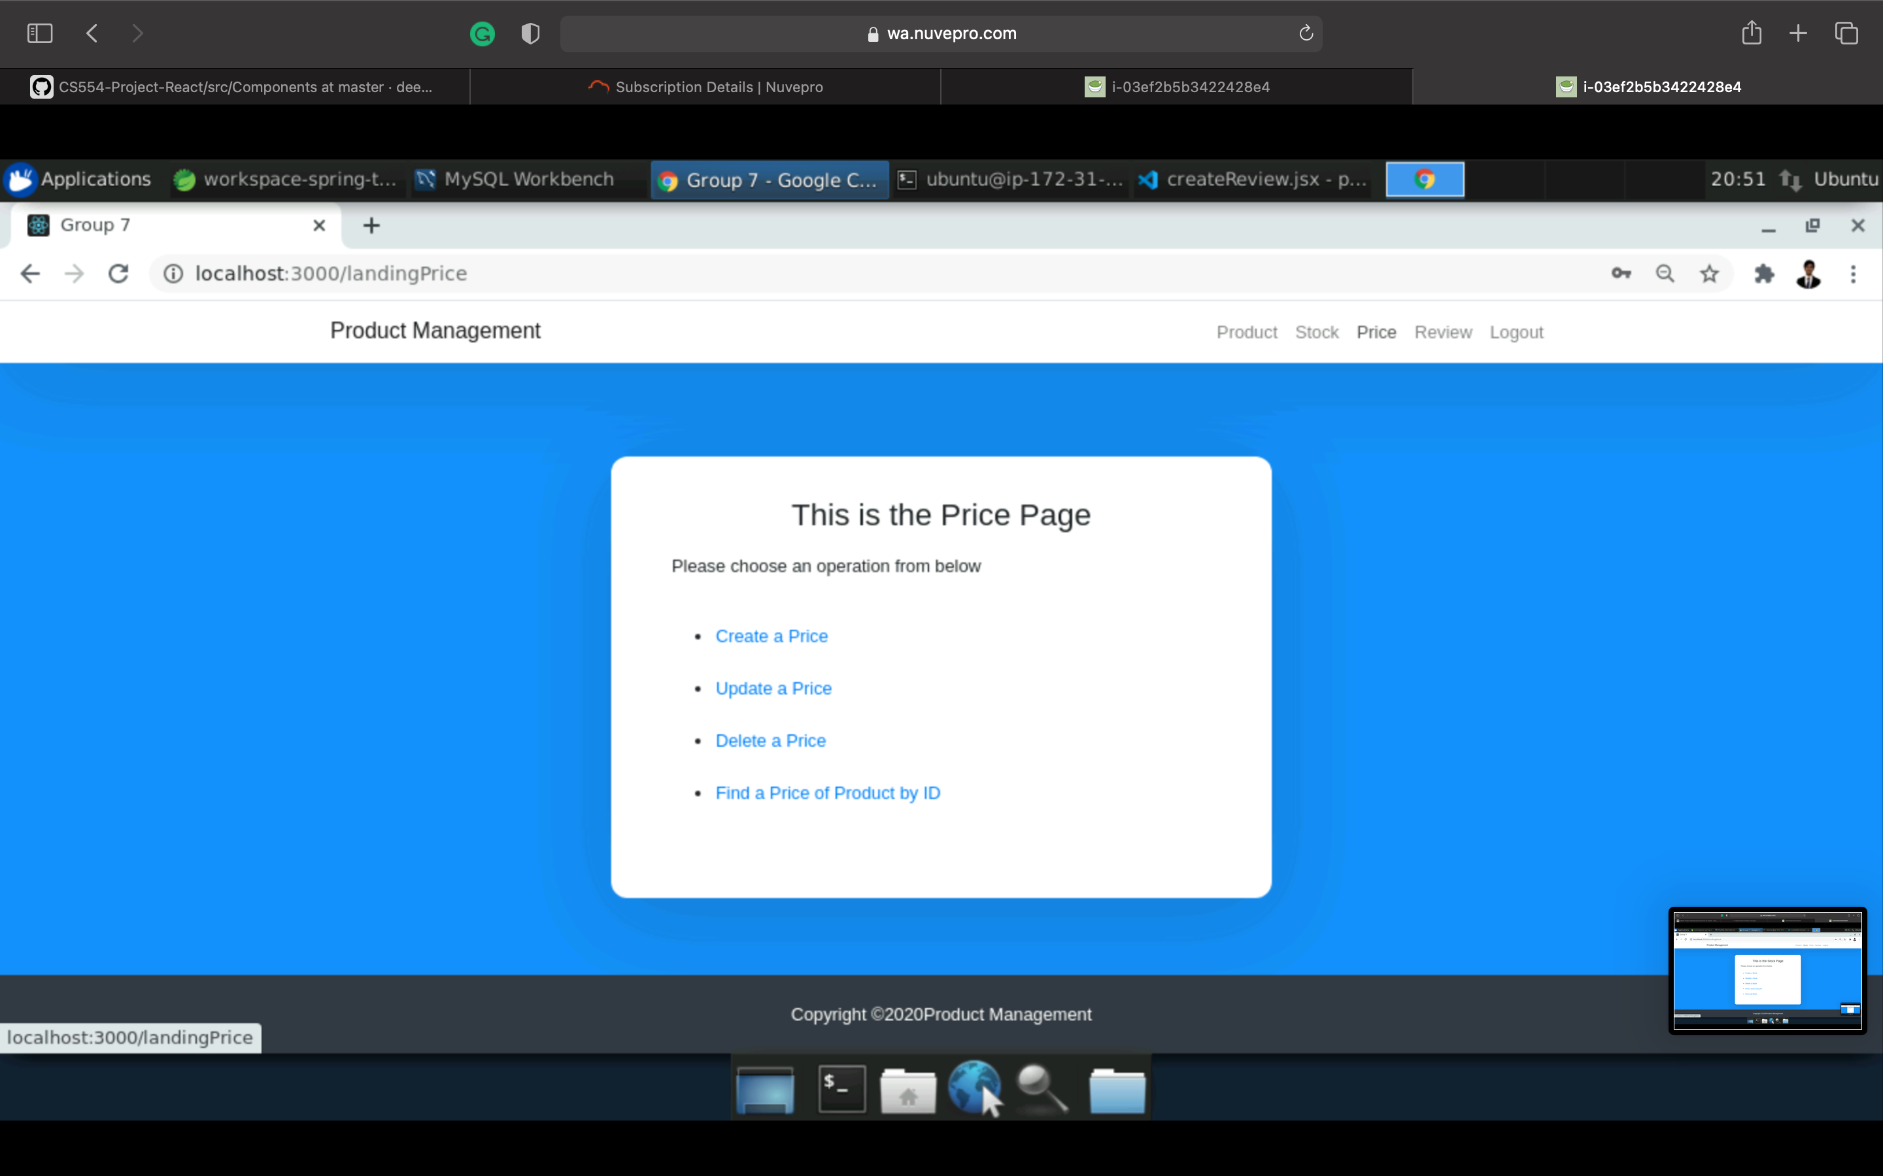
Services
PRICE: This service helps the users to add the price to the product, to update the price of the product, delete the price of a product, fetch the price of a product by its ID as well as of all the products

Slide 14
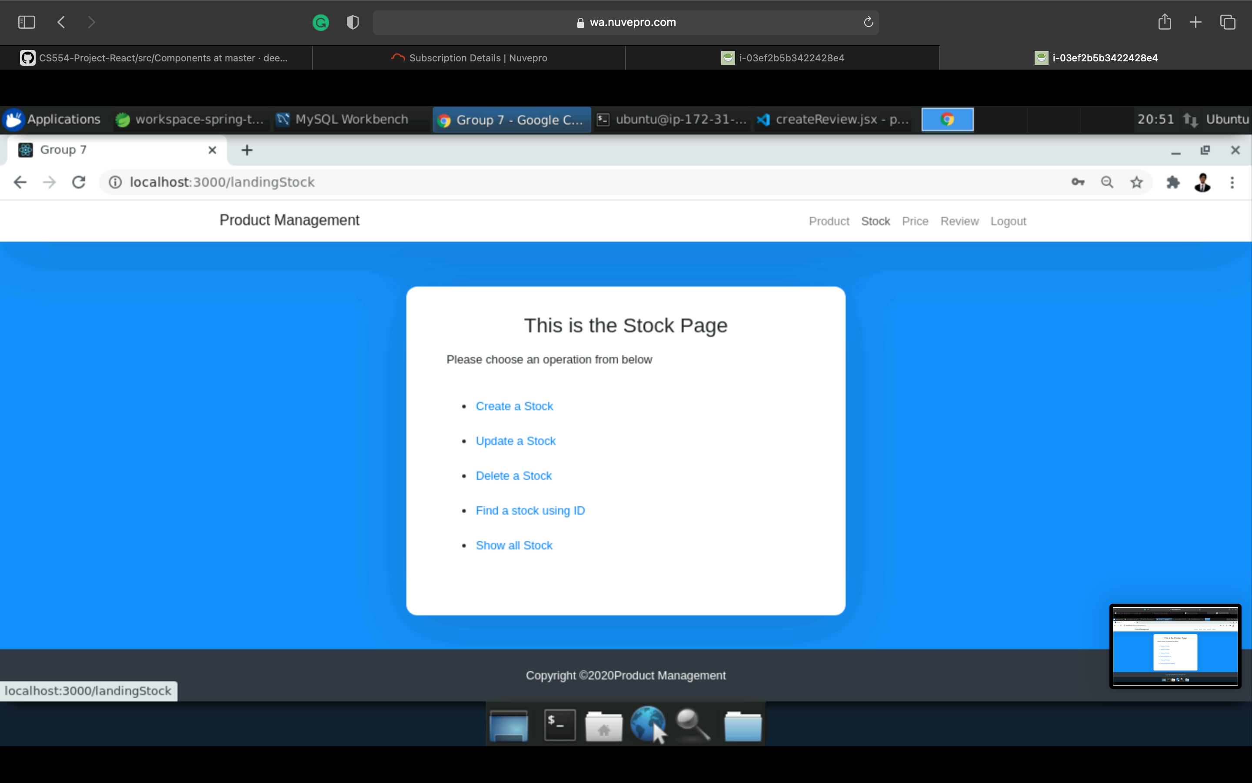
Services
STOCK: This service helps the users to create a stock, to update the existing stock, to fetch the stock details by ID, to fetch all the existing stocks details, to delete the product in the stock by its ID

Slide 15
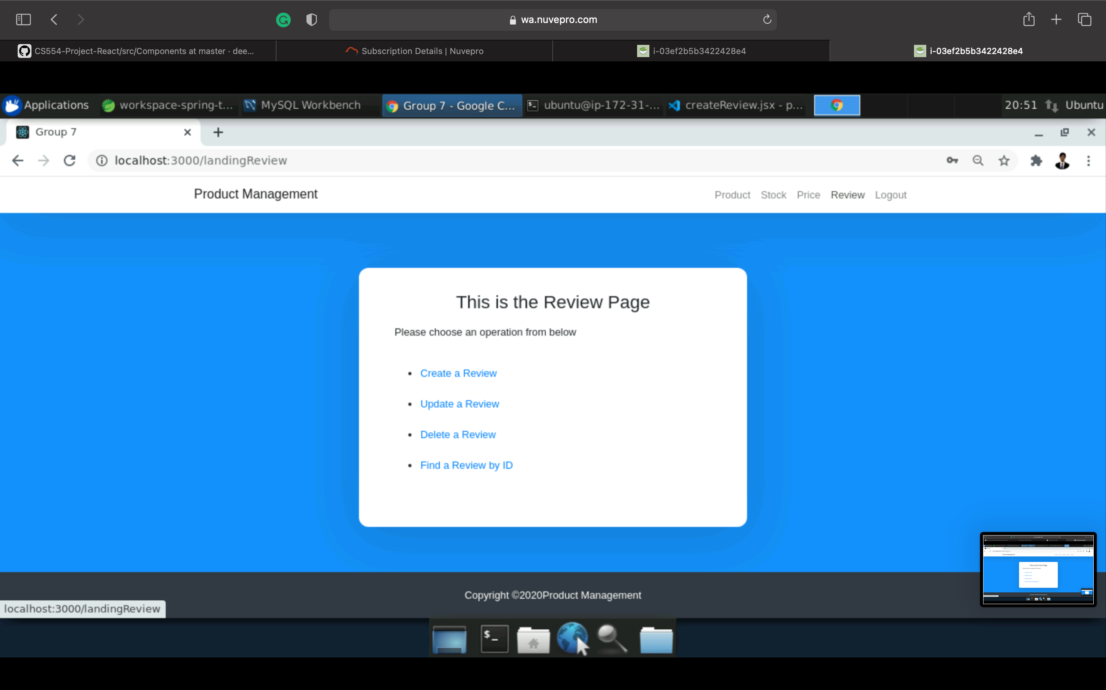
Services
REVIEW: This service helps in the users to add a review, to update the existing review, to fetch the review of a product by its ID, to delete the reviews, to fetch all the existing reviews of all the products,

Slide 16

Snap shots of the website

Slide 17
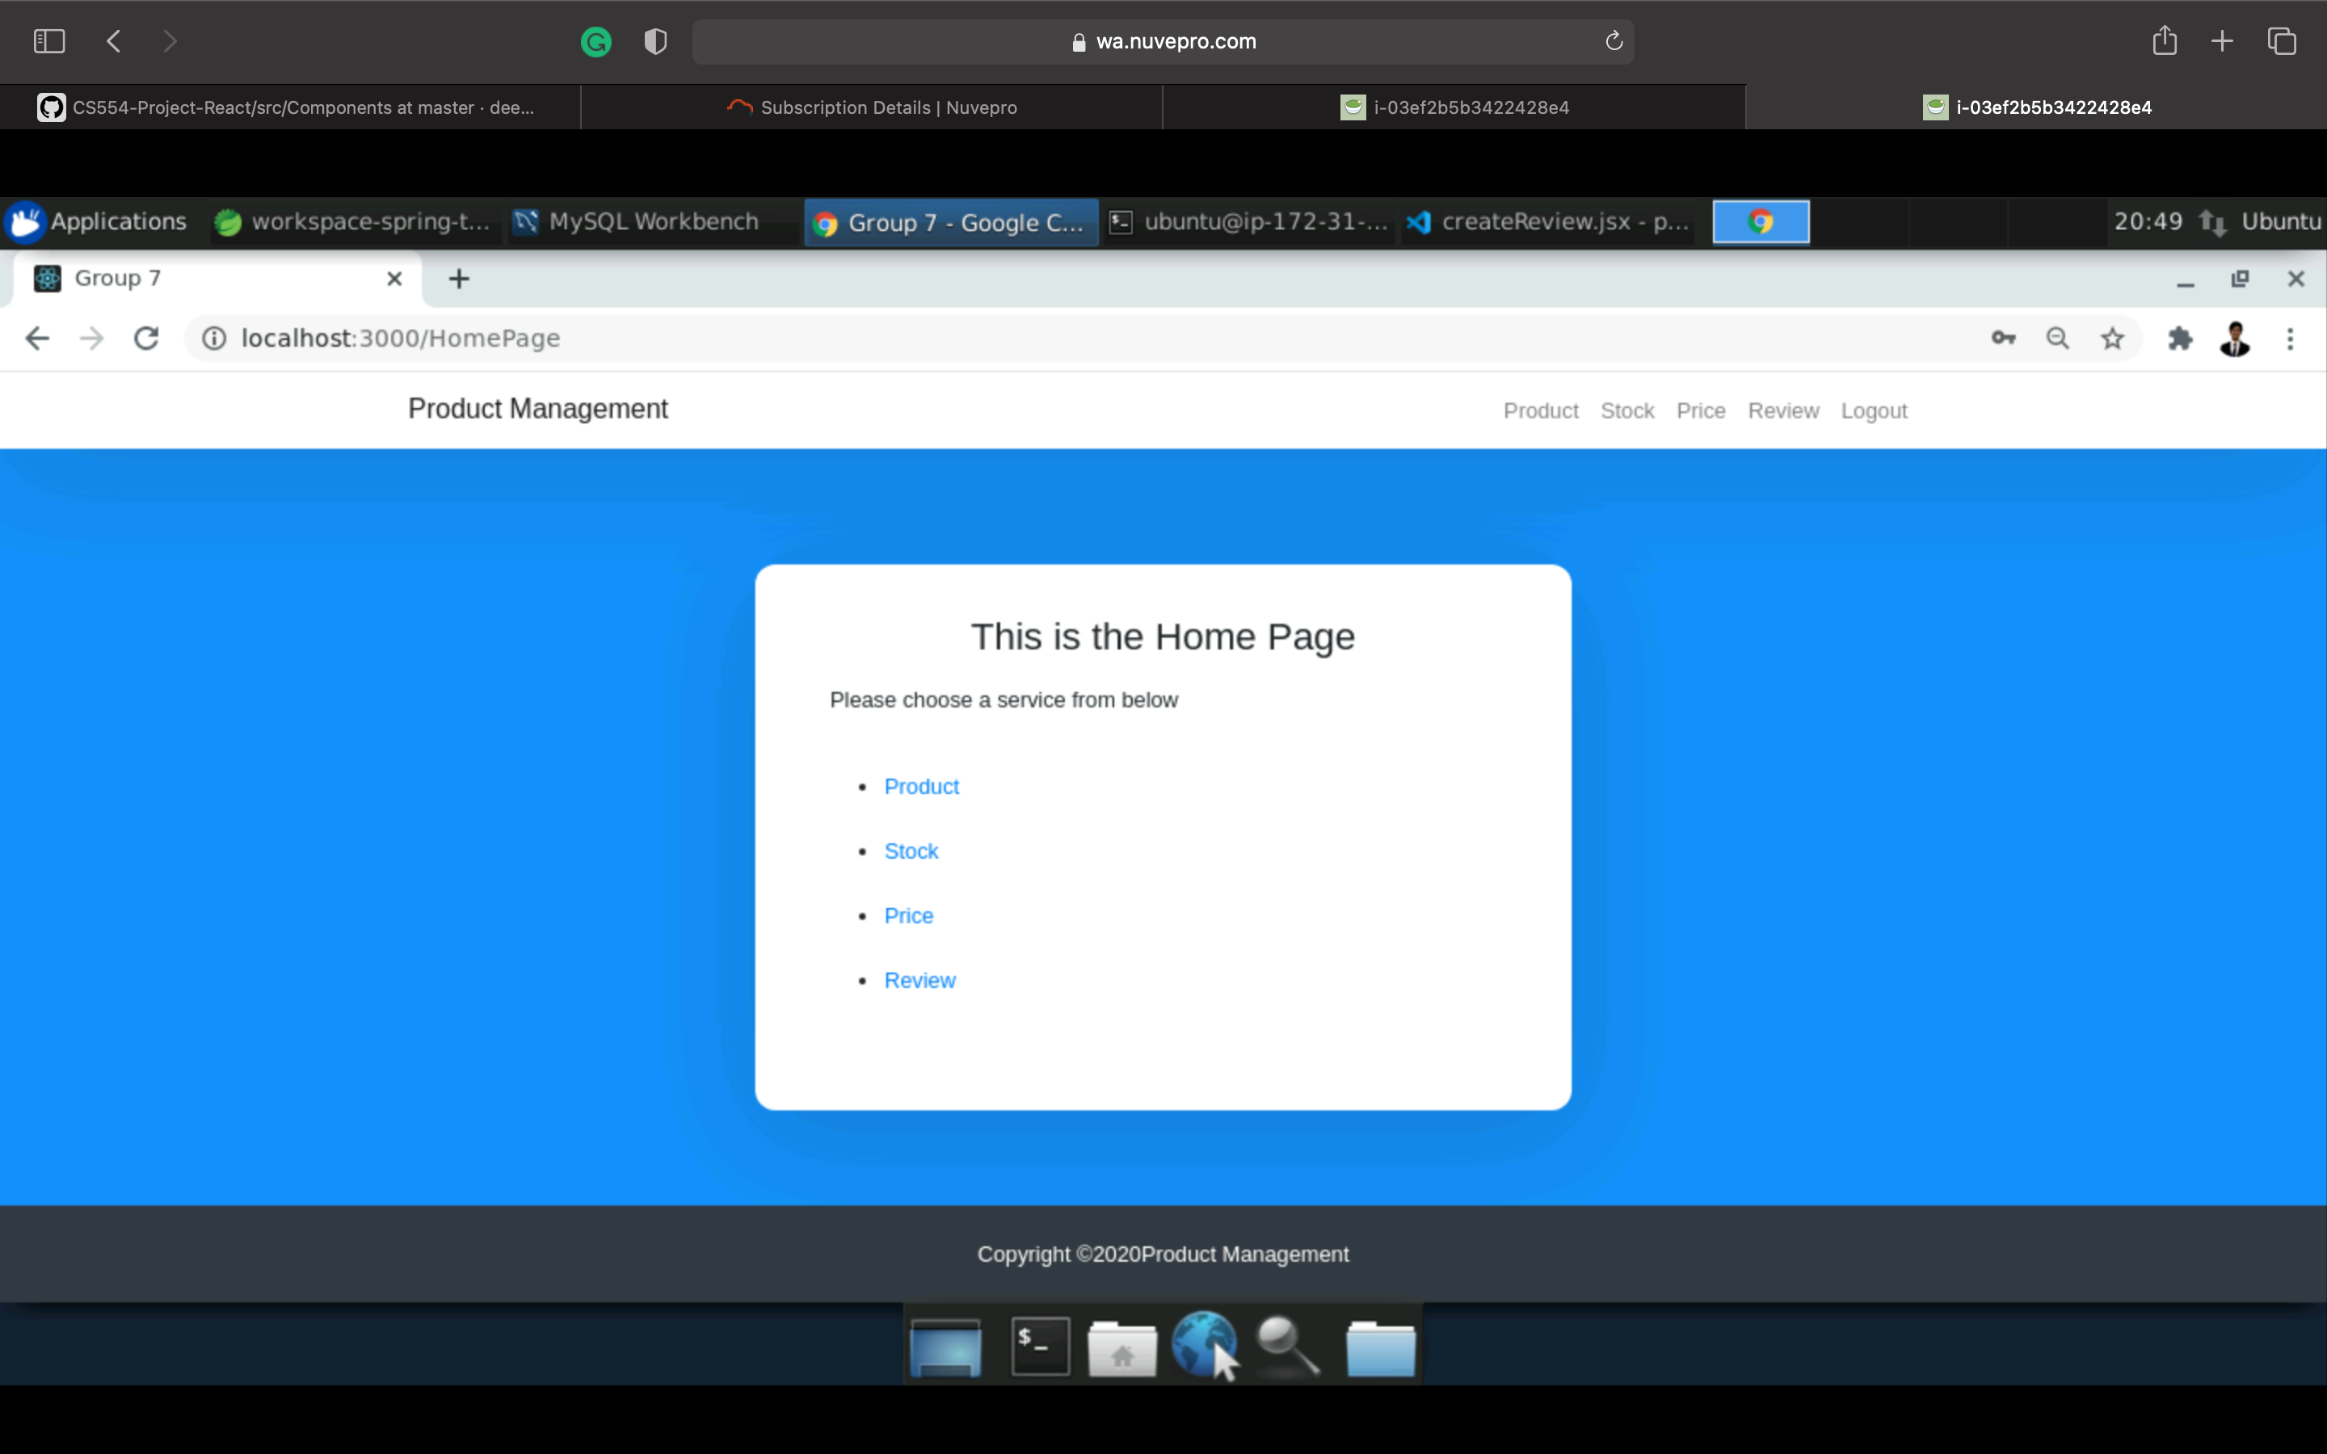
Home page for website

Slide 18
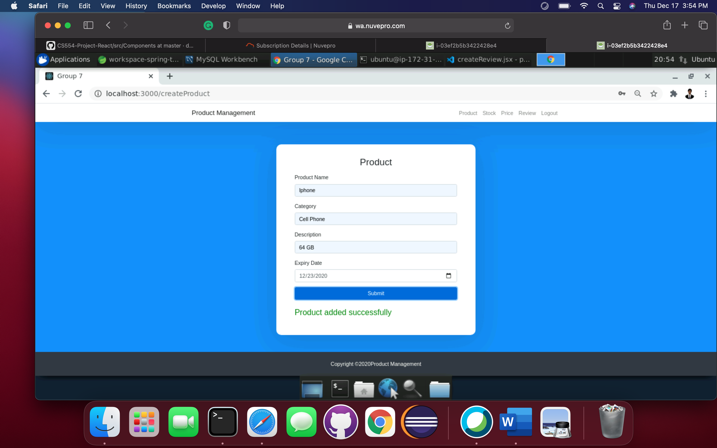
Add Page with success message

Slide 19
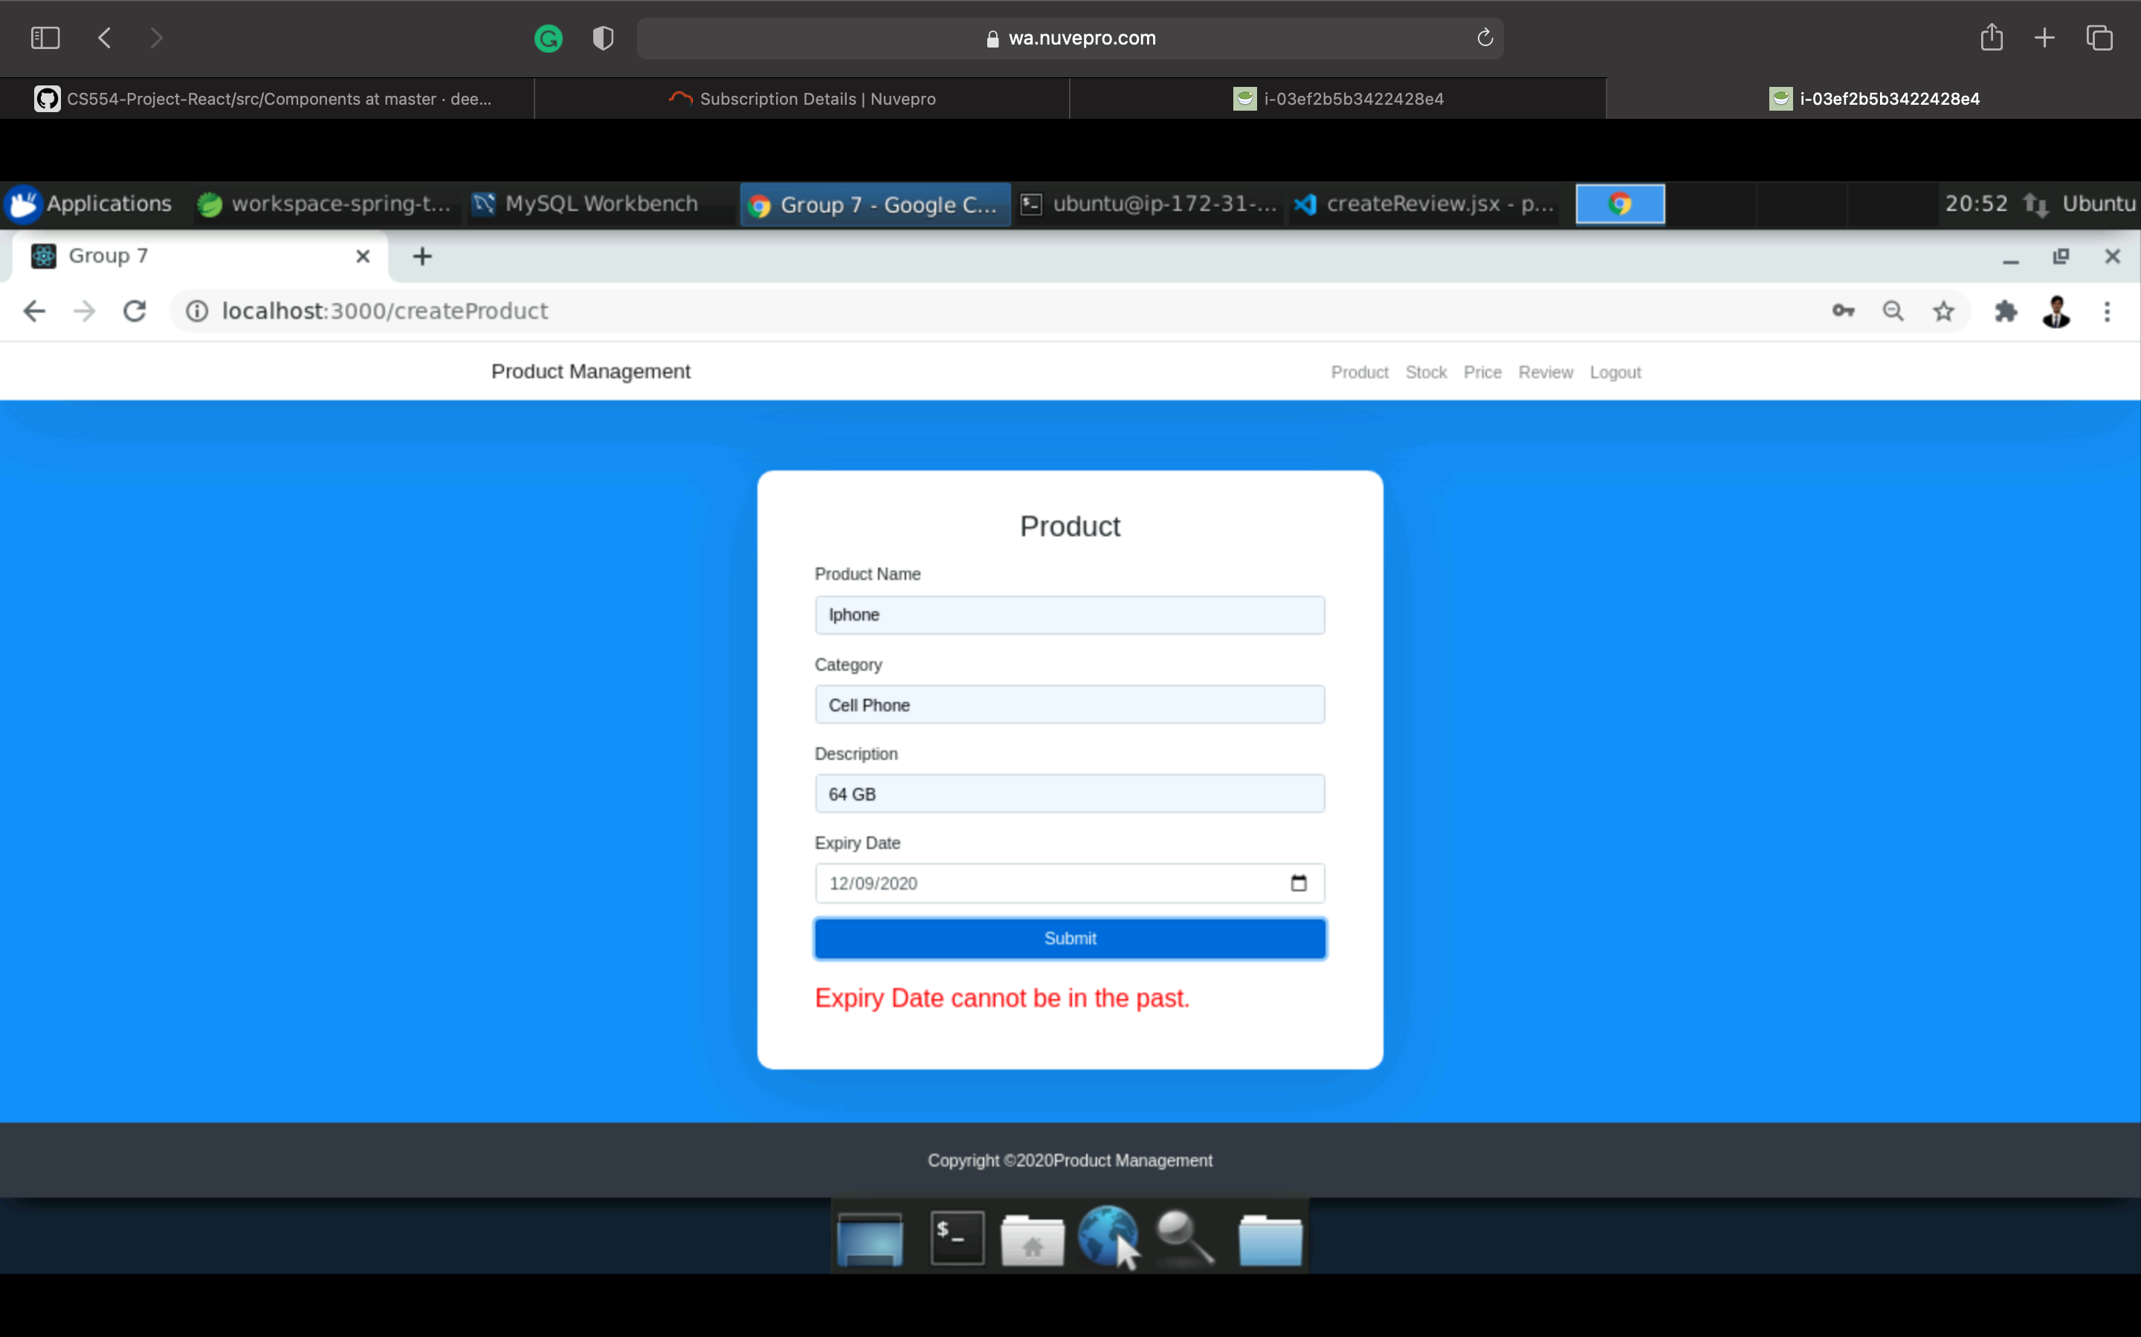
Add Page with fail message

Slide 20
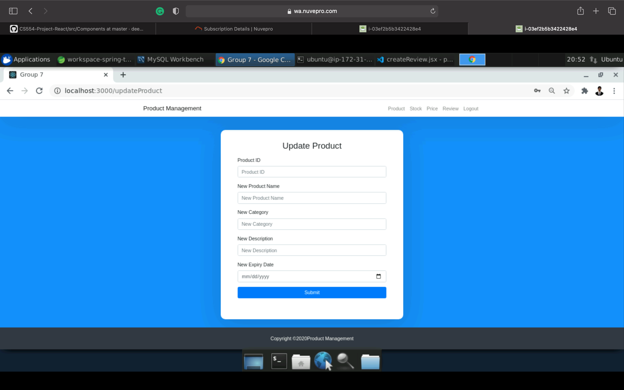
Update Page

Slide 21
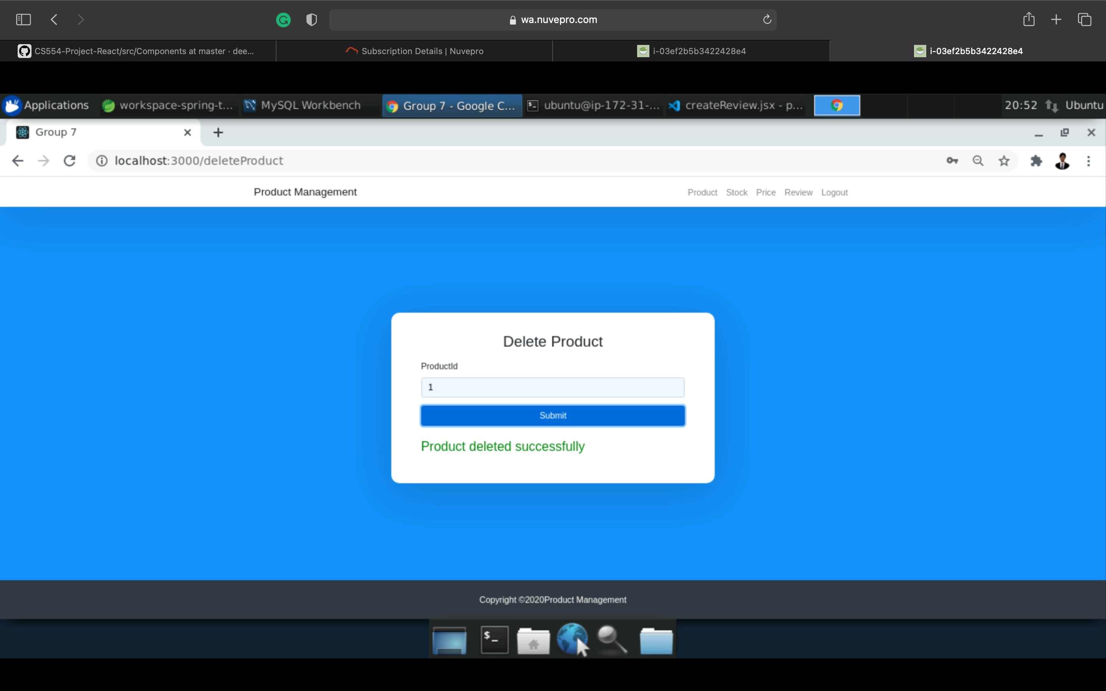
Delete page with success message

Slide 22
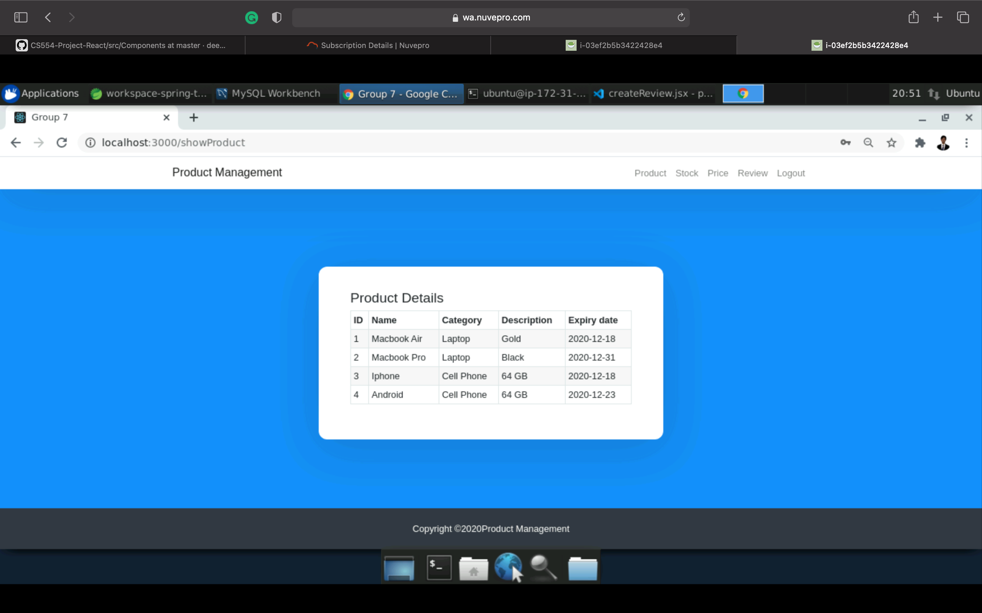
All Products display page

Slide 23
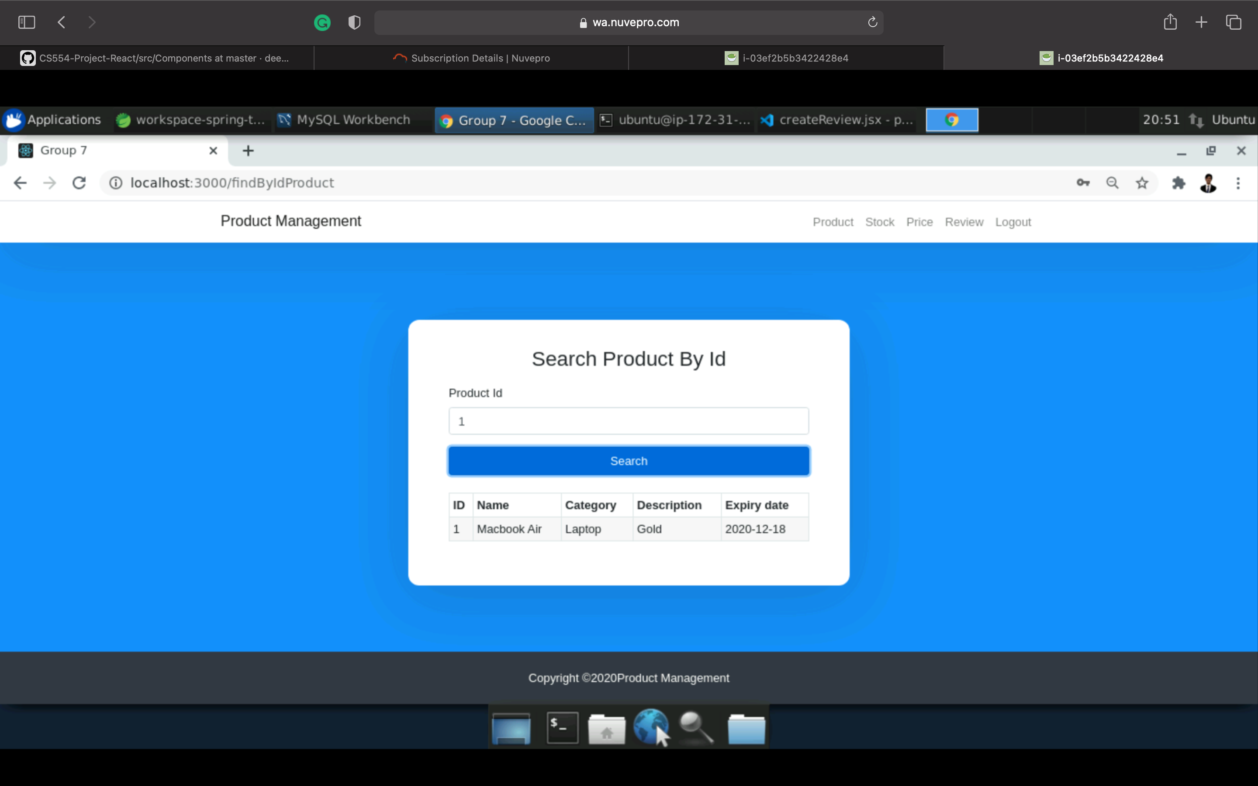
Display product by ID page

Slide 24
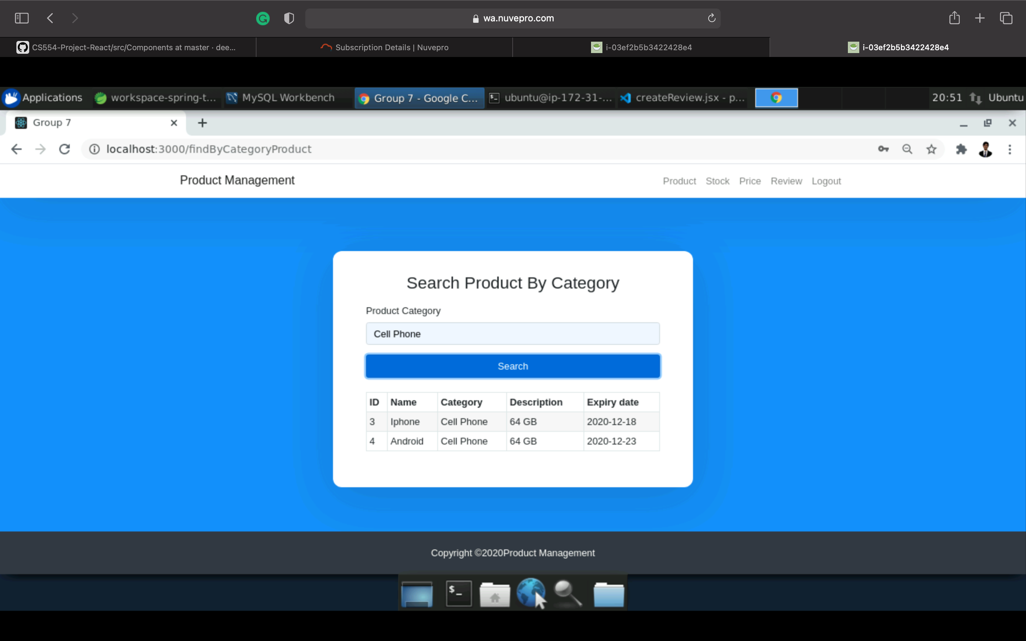
Display product by category page

Slide 25
Roles:
Name | Work done
Kunj Desai (Scrum master) (Full Stack Developer) | Created services, Controllers in backend. Created Microservices, docker files. Creating project structure for front-end back-end. CSS, login-sign pages in front-end. Authentication for front-end. End-to-end integration/Testing and bug fixing.
Saumitra Natu (Front end developer/QA) | Worked on front-end by creating the react pages. Added Authentication using Redux. Integrated front-end code. Tested front-end. End-to-end testing/debugging. Merged front-end and back-end code.
James Ortiz (Back end developer/QA) | Created models. Testing API using postman. Bug fixing.
Farin Habib (Front end developer/QA) | Worked on front-end. Added Authentication using Redux Creating pages. Testing front-end.
Prathiksha Balakrishna (Back end developer/QA) | Creating Repository. Testing API using postman.
Neel Rana (Back end developer/QA) | Creating Exception. Testing API using postman.

Slide 26

Thank you!

